Slide 1

TestPilot
Autonomous Web Testing Agent
Supervision
Dr. Basher Abdelfattah
TA. Muhammad Atta
Team Members
20220373 Hesham Abdelnaser Ali 20221151 Mostafa Mahmoud Hosni 20220212 Ali Raouf Muhammed
Graduation Project Final Presentation
Academic Year 2025/2026

Slide 2
The Problem: Fragile Web Test Automation
Current State of Web Testing
The Selector Fragility Problem
Quality Assurance has evolved from manual testing to automated frameworks, but a fundamental weakness remains: tests are coupled to implementation details.
DOM Structure Changes
Elements move within hierarchy, identifiers get renamed
Component Evolution
Frameworks like Selenium and Playwright rely on DOM-dependent strategies (CSS selectors, XPath). When UIs are refactored, these selectors break, creating a high maintenance burden.
Composition changes invalidate dozens of tests
Maintenance Burden
Cost grows with application complexity

Slide 3
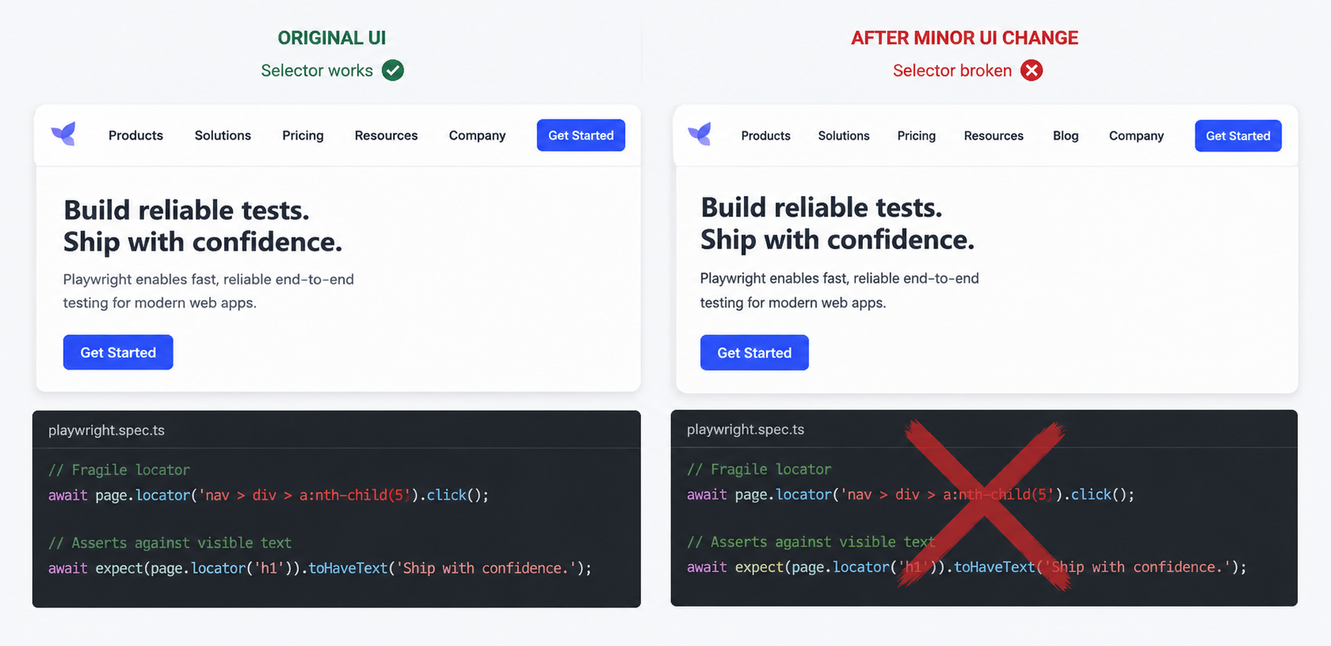
This creates a maintenance death spiral. You write a test, the UI changes, the test breaks, you fix it, and the cycle repeats. It’s a significant expense for software teams and makes CI/CD pipelines unreliable.

Slide 4
Project Vision & Objectives
TestPilot’s aim was to create an autonomous testing agent that reduces maintenance overhead and improves reliability by executing acceptance tests directly from natural language steps.
Eliminate Selector Maintenance
Accessible Test Creation
Visual Verification
Tests survive UI refactoring by grounding actions in observable UI state (screenshots & structure) instead of pre-written selectors.
Allows stakeholders (PMs, BAs) to contribute to automation, bridging the gap between business requirements and technical implementation.
Validate the actual user experience—confirming elements are visible, interactable, and not merely present in the DOM.
Approach: Use multi-modal LLMs to interpret natural language test cases and execute them dynamically, observing the page, reasoning, and acting without pre-written selectors. This approach can reduce reliance on fragile DOM selectors and minimize maintenance overhead.

Slide 5
Stakeholder Analysis
QA Engineers
Software Developers
Product Managers & BAs
Role: Author natural language test cases, configure environments, and evaluate test runs.
Expectation: Reliable execution with zero manual locator maintenance during UI changes.
Key Requirement: Structured step-by-step traces, execution logs, and annotated screenshots to easily distinguish actual application bugs from agent errors.
Role: Leverage test reports to rapidly reproduce, isolate, and fix codebase defects.
Expectation: High resilience against minor HTML refactoring, eliminating false alarm test failures.
Key Requirement: Granular debug data on failure, including the exact step, attempted action, and DOM state at the moment of failure.
Role: Define product features, requirements, and user acceptance criteria.
Expectation: Write and audit test scenarios directly in plain text without writing code or identifying CSS/XPath selectors.
Key Requirement: Direct mapping of business requirements to test execution to accelerate final release validation.

Slide 6
Autonomous Web Agents: The Core Concept
What is an Autonomous Agent?
TestPilot
An AI-driven system that perceives a digital environment (through visuals, code, or structure), makes decisions, executes actions (like a human user), and iterates based on feedback to achieve a goal.
TestPilot is an Autonomous Web Testing Agent designed specifically to execute end-to-end acceptance tests written in natural language.
Components
Key Capabilities of Web Agents:
Multimodal LLM: Uses a Large Language Model to perceive and understand the page via annotated screenshots (Set-of-Marks visual prompting) and structural accessibility trees.
Observe: Perceive the page state using screenshots and DOM data.
Reason: Plan the next action based on the current observation and the objective.
State Machine (LangGraph): Orchestrates step execution, verification, and recovery to ensure no steps are skipped.
Act: Execute the action via browser automation tools (clicks, typing).
Adapt: Handle errors and recover from transient failures.
Playwright Driver: A headless Chromium browser executes the actual interactions.
Note: Generalist agents (like those for booking flights) are open-ended. Web testing agents are different, they must follow strict, sequential steps and validate explicit intermediate assertions.
Definition: Acceptance testing in web development is the final phase of software testing where a website or web application is evaluated to determine if it meets predefined business requirements, user specifications, and acceptance criteria before being deployed to production.
This project builds upon the paradigms and frameworks introduced in "Are Autonomous Web Agents Good Testers?" (Chevrot et al., 2025; arXiv:2504.01495).[1]

Slide 7
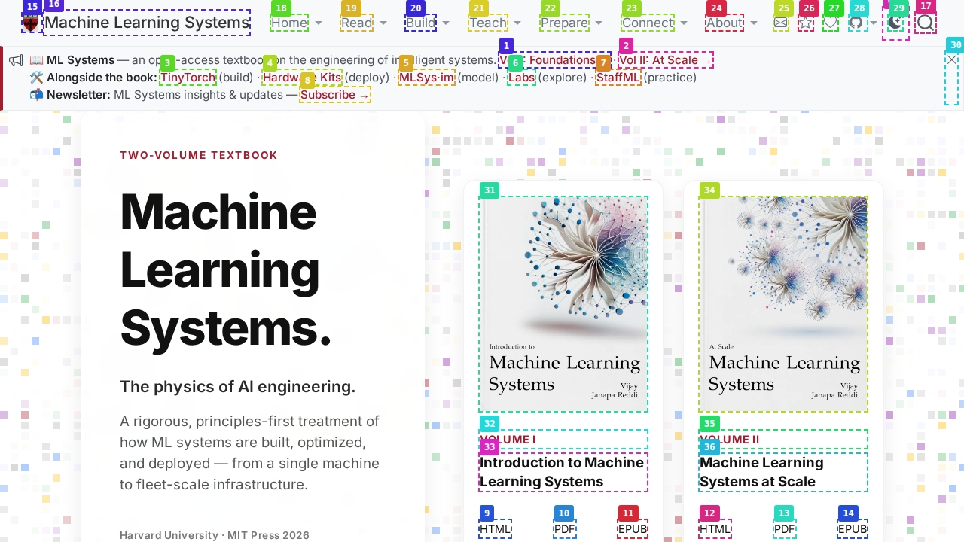
Visual Prompting via Set-of-Marks (SoM)
Interactive Element Extraction: Playwright dynamically parses the page's accessibility tree to isolate interactive components (links, buttons, inputs).
Automatic Bounding & Labeling: Distinct bounding boxes and numeric identifiers (such as [18] for "Home" or [31] for "Volume I") are programmatically overlaid on the screenshot.
Grounding the VLM: This annotated image is sent directly to the Multimodal LLM along with marks. The model reasons visually and simply specifies the numeric tag of the target element (e.g., "Click [31]").
Decoupled Execution: TestPilot translates this numeric choice back to the underlying DOM node to perform the click. This completely bypasses the need for fragile CSS or XPath selectors.

Slide 8
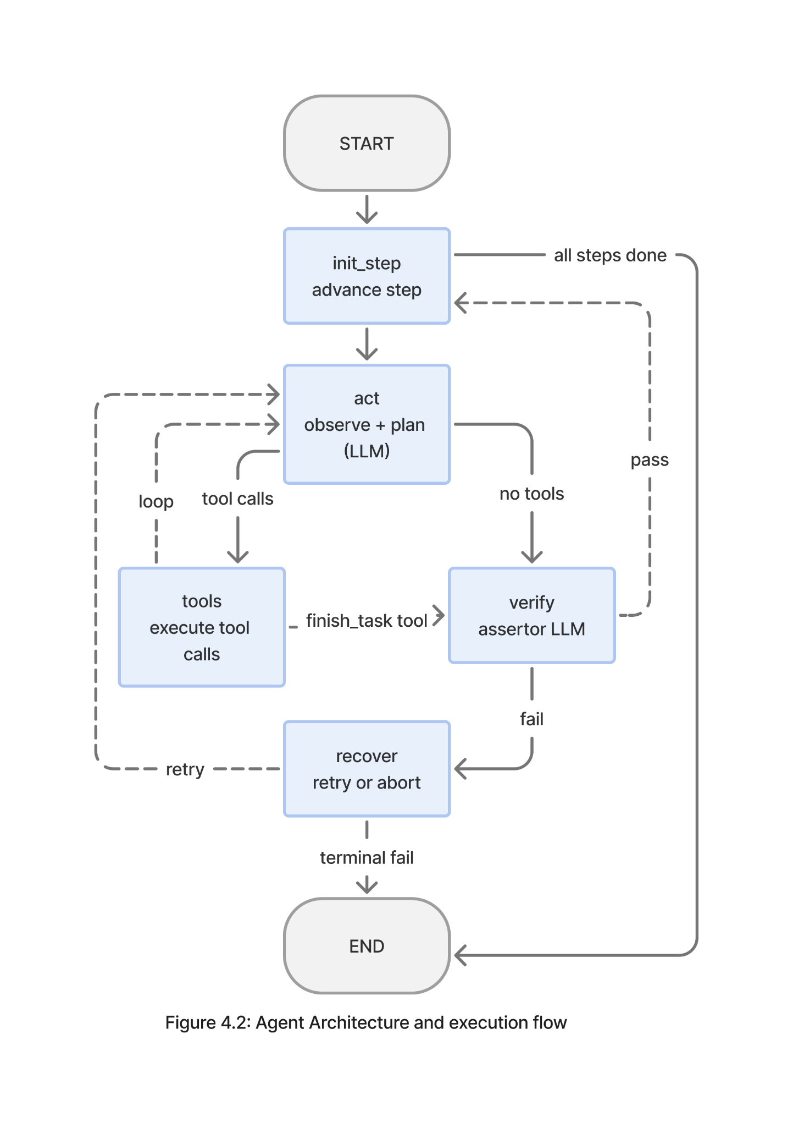
Agent Logic
Observe-Reason-Act Loop
The orchestration layer implements a continuous loop through specialized agent nodes that work together to execute natural language test specifications.
Actor
Assertor
Recovery
Executes actions on web elements based on current state and test goals
Verifies expected outcomes and validates test conditions
Handles errors and attempts recovery from failed actions
Feature Categories
The system extracts three categories of features from the browser environment, prioritizing multimodal inputs that mirror human testing behavior:
Visual Features
Structural Features
State Features
Full-page screenshots serve as primary input for element localization and assertion verification.
Accessibility tree snapshots filtered to include interactive elements (buttons, inputs, links) with their semantic labels,
Current URL, browser console logs, and sequential history of previously executed actions within the active test run, grounding the agent in temporal context.

Slide 9
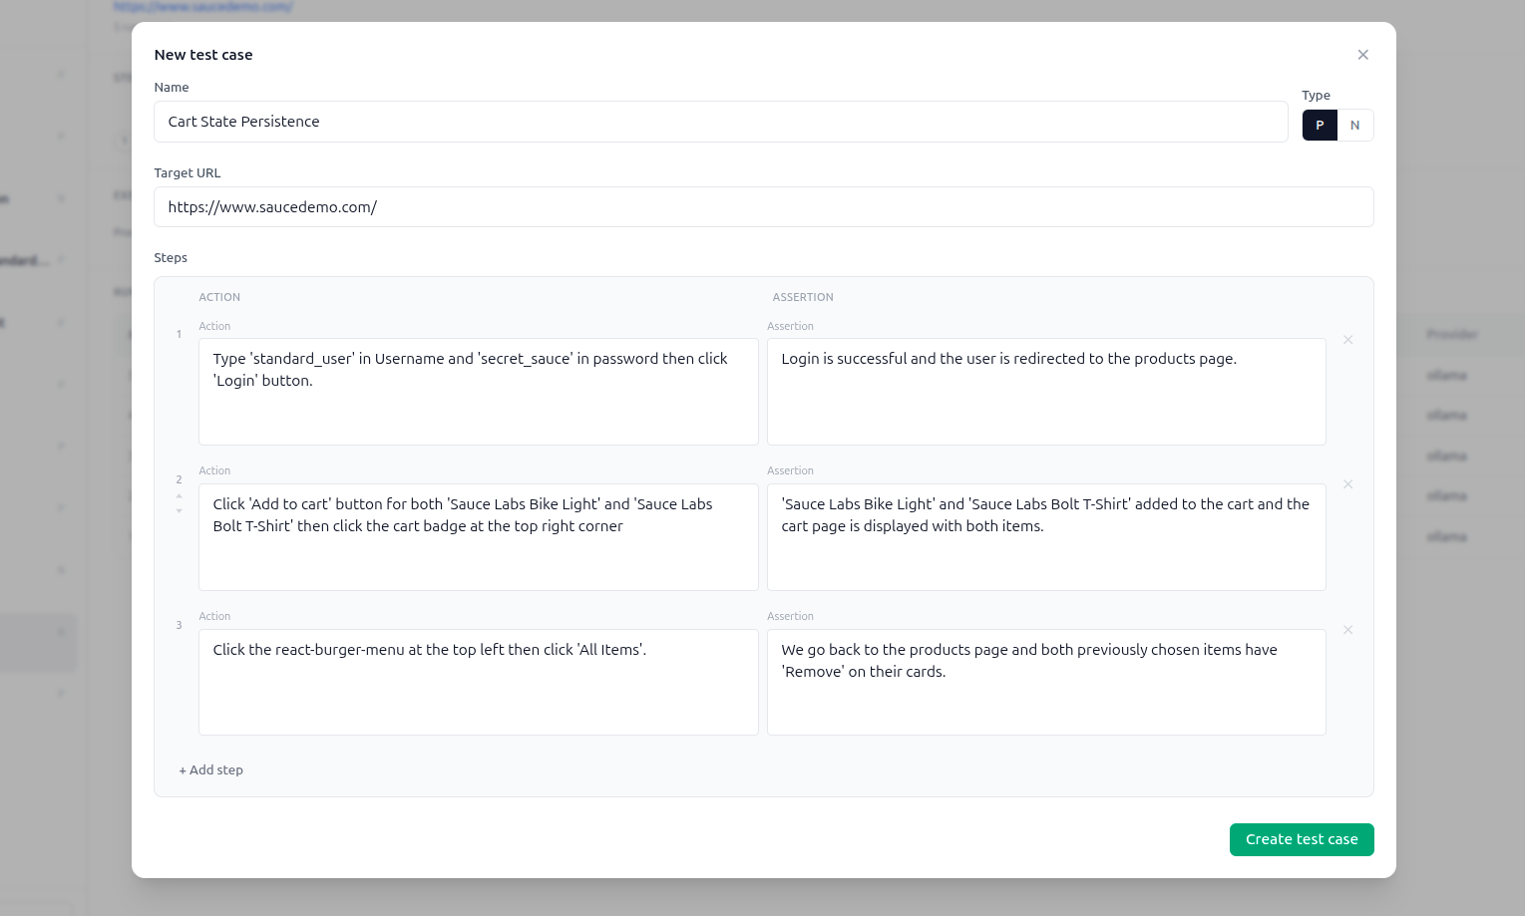
The Test Authoring & Editor Screen

Slide 10
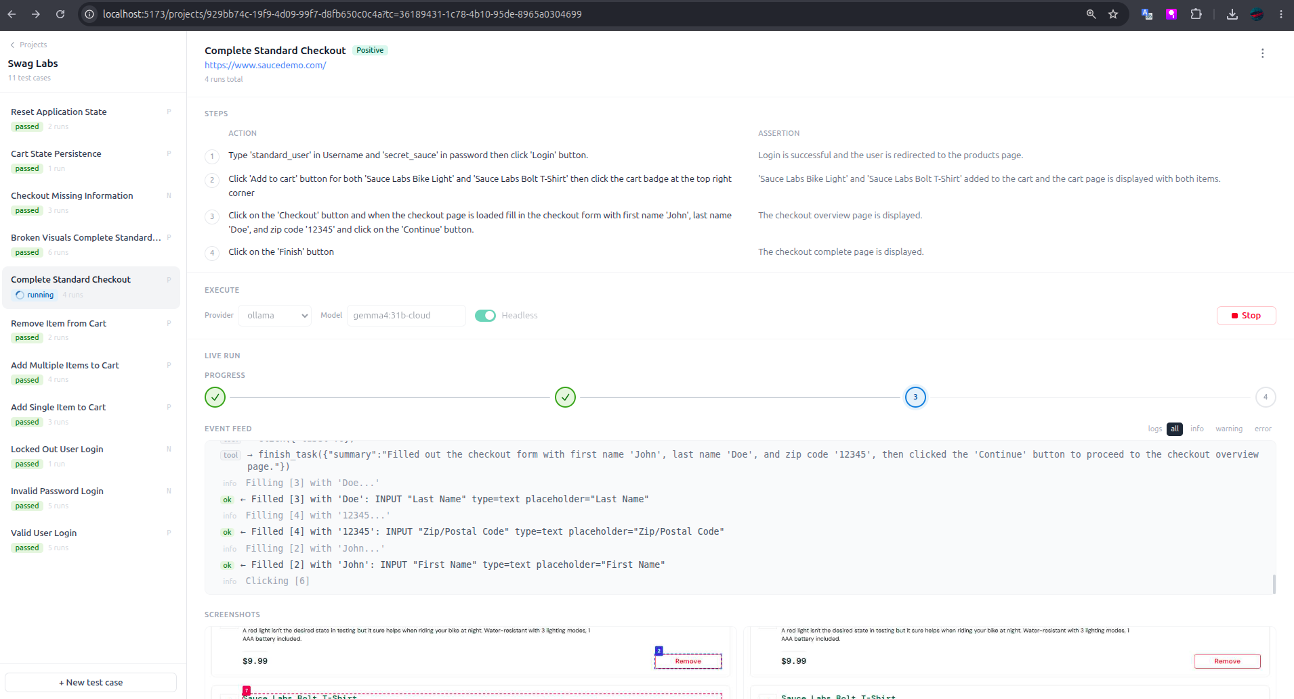
The Live Execution Screen

Slide 11
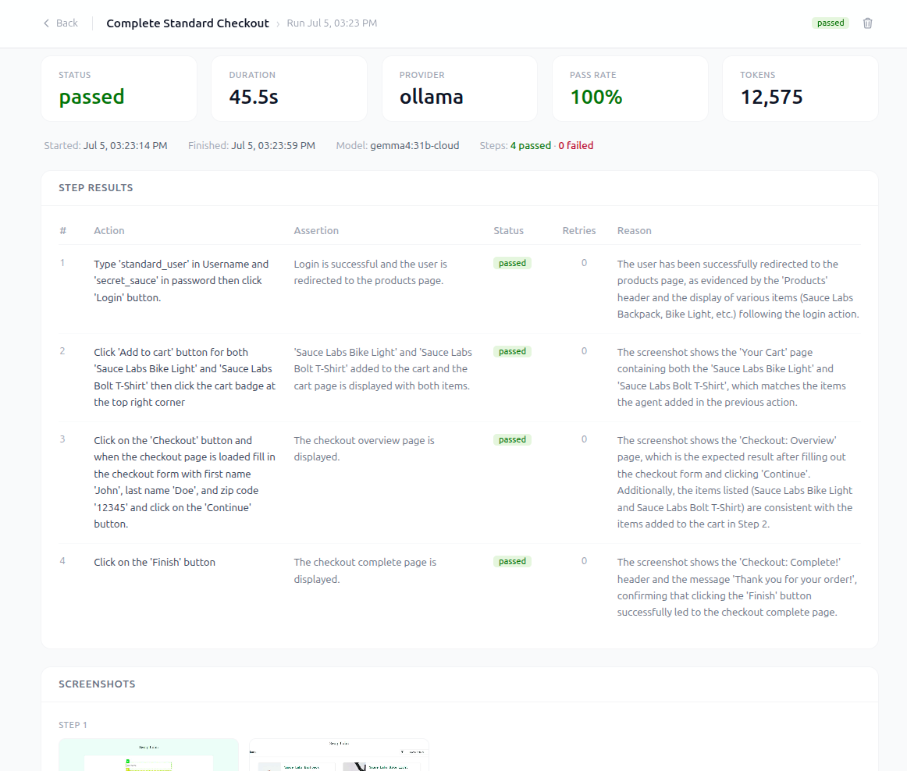
The Step-by-Step Execution Trace Screen

Slide 12
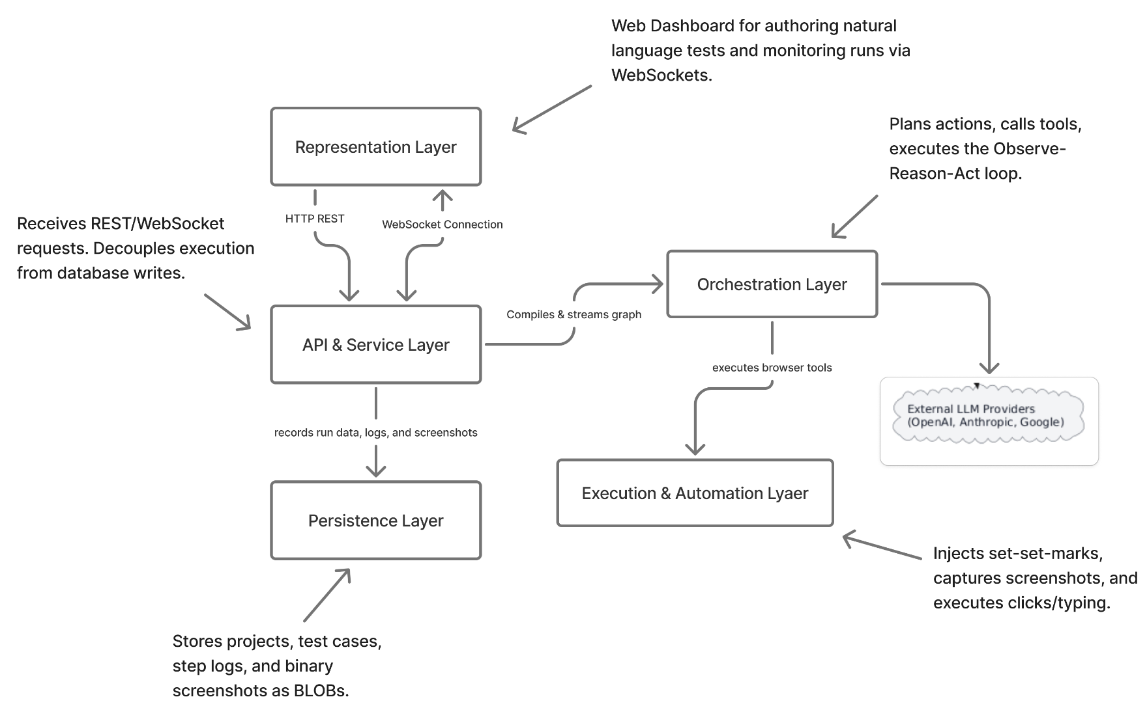
System Architecture Overview
Simplified version of Figure 4.1

Slide 13
Does it Actually Work?
Live
Demonstration

Slide 14
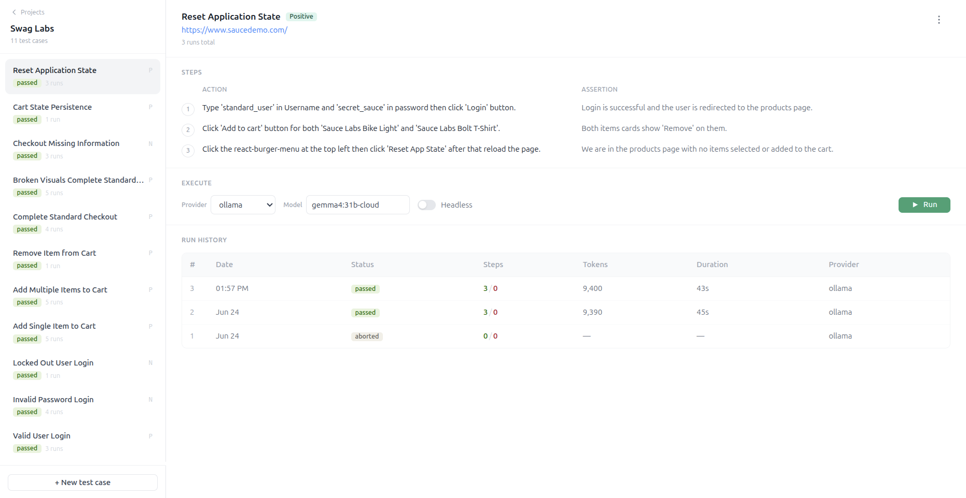
Evaluation & Test Results
To validate TestPilot, we built a comprehensive test suite using the public SauceLabs Swag Labs e-commerce sandbox. We wrote 11 natural language test cases, ranging from valid and invalid login attempts, multi-item cart manipulation, to complete checkout flow.
All 11 Test Cases Passed
The most important takeaway from this evaluation is how they passed. These tests relied entirely on visual annotations and natural language steps. No traditional CSS selectors were written for any of these 11 tests. This proves our primary objective that we can completely eliminate the selectors' maintenance burden.

Slide 15
Engineering Challenges & Lessons Learned
AI Self-Bias in Action Verification
State Machine Crashes via Free-Form Text
Blindspots of Purely Visual Grounding
Problem: Combining step execution and assertion verification in a single LLM call, leading to high error rates where the model repeatedly verified its own incorrect actions as "passed."
The Engineering Solution: Decoupled the state machine. We isolated verification into a dedicated VerifyNode (Assertor) that objectively evaluates clean, unmarked screenshots to guarantee reliable test outcomes.
Problem: Relying on raw, free-form text outputs from language models consistently introduced formatting exceptions, causing the orchestration graph (LangGraph) to crash mid-execution.
The Engineering Solution: Enforced strict JSON schemas across key state transitions. Using Pydantic models for the assertor and recovery node completely stabilized our execution state graph.
Problem: While the Set-of-Marks (SoM) overlay worked well, purely visual elements were vulnerable to overlapping bounding boxes, low color contrast, and hidden DOM nodes.
The Engineering Solution: Developed a hybrid perception layer. We combined full-page visual screenshots with filtered structural accessibility tree metadata to ensure reliable, multi-modal element localization on modern.

Slide 16
Future Work
Future work can extend the project by:
Local Vision-Language Models: Currently, TestPilot relies on cloud APIs (OpenAI, Anthropic), introducing latency and cost. Future work could include integrating fine-tuned local open-source models to eliminate API costs and ensure absolute data privacy.
Parallel Execution Scaling: TestPilot runs one test at a time. Future work could implement parallel browser workers using sandboxed container instances to drastically reduce validation time for large test suites thus increasing the throughput.
Broader Observability: Future iterations could ingest browser console logs and network traffic, allowing the Assertor to detect silent JavaScript errors or failed backend API calls that don't appear on the visual interface.

Slide 17
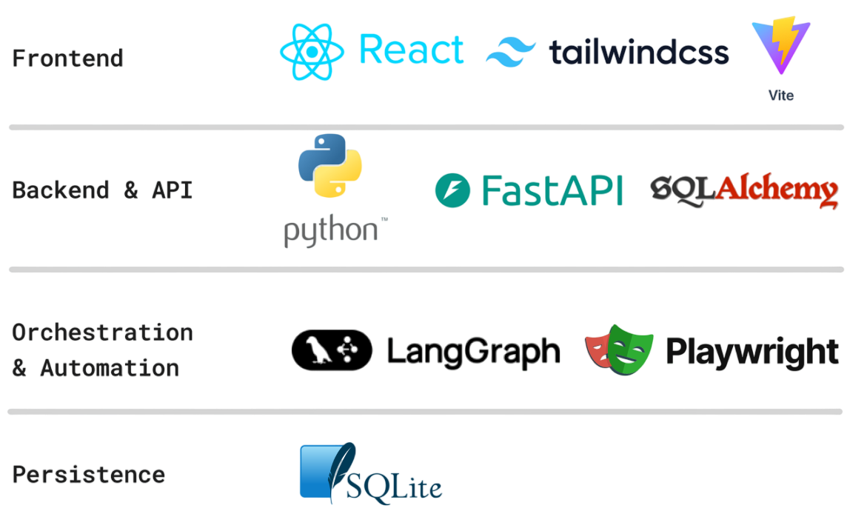
Technology Stack

Slide 18
Thank You

